Slide 1
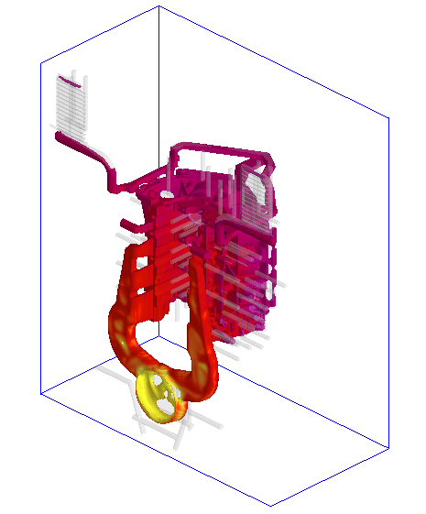

A Modeling and Experimental Investigation on the Formation of Acicular Silicon and Sludge in High Pressure Die Casting of a Modified A383 Alloy
CFD Model of fluid flow and heat transfer in the HPDC process to predict Local cooling rates
Comparison of
Local cooling rates vs.
local size and shape of phases (eutectic silicon and Fe-rich ‘sludge’ intermetallic)
Mikko Karkkainen, University of Alabama

Slide 2
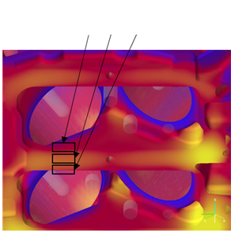
3
(back)
2
(mid)
1
(front)

